Slide 1
ClaimSphere Automation

Slide 2











ClaimSphere Automation Framework (CAF)
CI Based Execution – Jenkins
Execution platforms
Test Automation Tools
KEY HIGHLIGHTS
Page Object model driven approach Extends to enable BDD through integration with Cucumber Multi-Platform support - Windows / Linux
BENEFITS
Design scalability (through ease in test script reusability and maintainability) Execution scalability (through CI and BDD implementation)
Test Suite Repository
Driver Script
Browsers
Data Handler
Page object
Handler
Config Handler
Databases
Component Libraries
Utility Libraries
Functional & Business Libraries
OS
Error & Exception Handler
Reporting Libraries
Product Under Test
Reports
Notes:
CAF is a framework for Behavior-Driven Development (BDD). It focuses on testing the features of program by defining the stories in scenarios that express the desired behavior in a textual format.
Overview of format (Given, When, Then)
A scenario is a collection of executable steps. In CAF it is expressed in Given, When, Then format.
Given step represents a precondition to an event
When step represents the occurrence of the event
Then step represents the outcome of the event

Slide 3
Target State - Early Automation Work Flow- In sprint
Analysis
Design
Coding
Test execution
Defect Fix Retest
Test Reporting
Product Owner
Themes - Features
BA
User Story
Code deployment
Defect Fix
Manual Tester
Requirement Analysis
Manual Test execution
Manual Retest
Feature File Creation
Step Definition & Function creation
Test Data creation
Test Reports
Automated Scripts for build stability validation
Report Defects
Creating test methods in GIVEN WHEN THEN format
Test steps and Asserts are written
Automated Scripts CI Process
Automated script run during execution and defect retest
Automation Tester
Test framework design
Automated Test Scripting
Automated Script Run
Automated Test Reports
Product Owner
US demo/ Acceptance
Automation
Manual
3 Layer Framework Design
Technology Layer – Reusable across applications. Interacts with the application technology layer.
Business Layer - Reusable business methods across the test phases. Interacts with technology layer through method calls. Business test methods created in sprint is reused in the regression , Integration testing.
Functional Layer - Functional call for business methods as per the test case flow in various test phases of the application.
Functional Layer
Functional Layer
Functional Layer
Functional Layer
Functional Layer
Functional Layer
Business Layer
Business Layer
Business Layer
Business Layer
Technology Layer

Slide 4
CS Automation Progress
Automation Backlog vs Progress
Product | Total Test Cases | Total Automated Test Cases | Remaining Test Cases To Automate
Clinical+ | 36534 | 20086 | 16448
QaaS | 172325 | 111939 | 60386
StarSERV | 4166 | 3933 | 233
Grand Total | 213025 | 135958 | 77067
Automation Type wise Count
Row Labels | Batch TC Count | UI TC Count | DB Validation TC Count | Reports Validation TC Count
Clinical+ | 519 | 10985 | 4185 | 4397
QaaS | 127 | 52 | 44783 | 66977
StarSERV |  | 3933
Grand Total | 646 | 14970 | 48968 | 71374

Slide 5
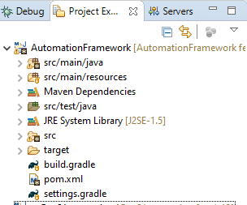
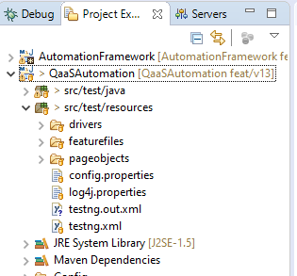
ClaimSphere Framework
Automation Framework Project
This Project consist of reusable common methods which can be used for all the module
QaaSAutomation Project
This Project consist of product specific methods

Slide 6
Environment
IDE – Eclipse
Web Driver – Selenium
Framework – TestNG
Build Tool – Maven
BDD – Cucumber
Logging – Log4j.xml
Reports – Extent Report
CICD – Jenkins

Slide 7
Reporting
Extent Reports
Selenium provides inbuilt reports using TestNG on the console window which provides information on the steps that are executed as part of the test case
In order to deliver a detail statistical report to the major stakeholders we use Extent Reports which help us customize the format and required details
It generates the report in HTML format which is more presentable as shown in next slide

Slide 8
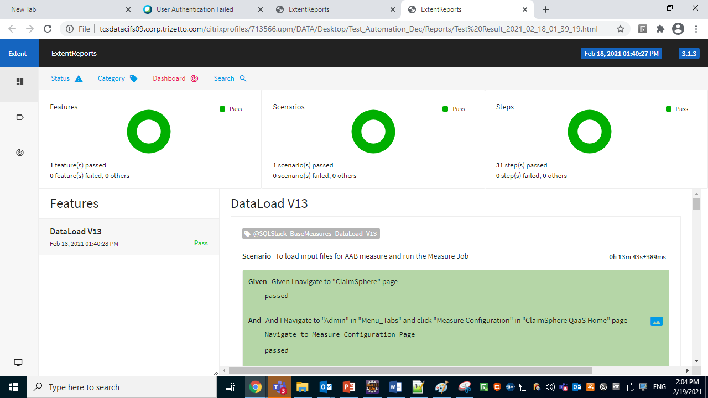

Slide 9
Tools Developed
S.# | Tool | Description | Impact
1 | Data Masking Tool | SQL-based data masking utility which de-identifies member PHI for the full set of HEDIS files, while maintaining referential (database) integrity. Performance-tested to handle large files. | This utility helps us to de-identify any Customer data that is made available for Product testing.
2 | IDSS Validation Tool (Used by Product and by HPC Teams) | Automated validation of the content of files submitted by plans to NCQA. Java-based tool that validates the content for the associated 80,000+ data elements. (Joint effort with QA and HPC teams.) | Improves quality of plan data; prevents rejections. Savings (annual) = 2112 hours.
3 | Measure Rate Reconciliation | Excel macro that compares the rates for all measures between the product versions (e.g., version 12 vs. version 13). | Identifies potential defects and promotes understanding of the impact of any requirement changes between HEDIS seasons. Savings (annual) = 1056 hours
4 | Test Data Generator | Java-based utility used to generate test HEDIS files for load testing and for functional testing. Useful in generating the many combinations of values needed for Measures testing. | Savings = TBD
5 | Input File Consolidation Utility for Continuous Integration | Tool to consolidate the individual Measure files generated by various employees/teams. These consolidated input files are used for integration testing. | Speeds up testing cycles. Savings (annual) = 1320 hours
6 | Feature File To Test Scenario generation Tool | Excel macro used to convert feature files (used in automated testing) into user-friendly lists of test scenarios per Measure. | Aids the QA and Product teams to discuss, understand, and approve test scenarios, along with identifying any gaps in test coverage. Savings (annual) = 704 hours

Slide 10
Thank You !!!

